Slide 1
Stack overflow VSCode Extension
Group 11
Annanya Pratap Singh Chauhan
Arpit Gupta
Aryan Agrawal
Shivang Dalal

Slide 2


Problem formulation
Stack Overflow provides one of the largest Q & A platforms for programmers.
Its search algorithm relies on simple text-based search and adding tags in questions requires prerequisite knowledge.
Each question's url needs to be visited to read the complete question and see the answers.
Integrating this functionality within an IDE will streamline the querying process.
Hence through this project we proposed an extension that will take a user's query, intelligently generate tags and display the results in the IDE window itself.

Slide 3
Achieved goals
Processed a large Stack overflow dataset to form a corpus.
Created a Word Embedding generating model.
Designed a deep neural model for optimal tag prediction based on user's search query.
Created a search index mechanism using cosine similarity of predicted tags and mean word embeddings.
Developed a Visual Studio Code extension to integrate the search model into a development environment.
Packaged the search model as a standalone python server for outputting results of user queries.

Slide 4

Data COLLECTION AND Data pre-processing
Collect data from Stack-Overflow Question-Answer Dataset using Google Big Query. Consider only python data.
Each row corresponds to a Question-Answer pair.
Aggregate all answers for a particular question to create a single row for each question.
Remove HTML tags
Remove punctuations, inline code, stop words and normalize the number of upvotes for each question.
Also create a corpus by combining question title, question body and question answer.
This corpus is used to train the word embedding model. We use gensim word2vec to create our word embedding model.

Slide 5
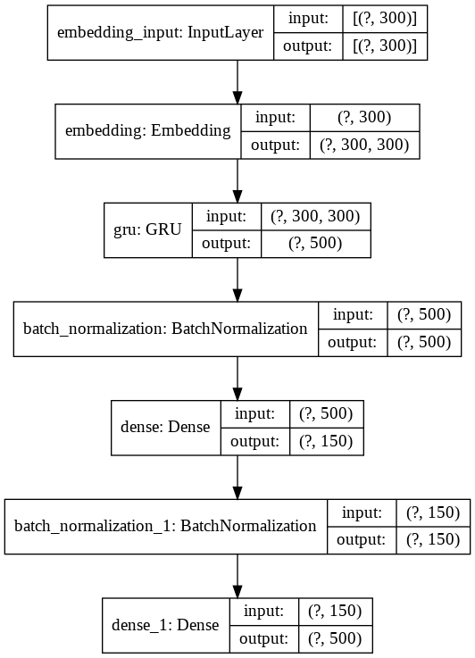
Tag predictor Model
The goal of this model is to predict stack overflow tags for a given query.
The first layer in the tag predictor model is the word embedding layer. This layer is loaded with weights from the trained word embedding model.
The second layer of the model is a GRU layer. This layer can generate high layer relations between parts of query.
The prefinal and final layers are dense layers with cells 150 and 500 respectively. The final layer has 500 activation units as we have considered only 500 tags in our prediction dimension
The model is trained on question titles and their corresponding tags.

Slide 6
Search result generation
Import Database and Word Embedding Vectors
Calculate the mean embedding vector for all the titles in our database and store it.
Each search query is first processed (Converted to lowercase->Remove punctuation -> Remove stop words)
Predicting tags on our search query and calculating its cosine similarity with all question tags.
Calculating mean embedding vector of query and calculating its cosine similarity with the mean embedding vectors of all questions in our database.
These two cosine similarity values are added with the score of each question to index our search results.

Slide 7
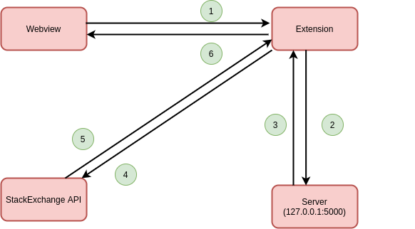
VS Code Extension Development
VS Code Extension works on the runtime environment of node.js.
Extension Development has two parts:
Flask Server: To load and run prediction models in python.
Extension in JavaScript: It has three main files-
Extension.js : Contains Activation function which activates extension. Register commands bind the main function.
App.html: Controls the display of search results in HTML format.
Package.json : Information about modules used in extension.
For each search query extension calls the python server which return top predicted results. These results along with the answers are then displayed.

Slide 8


Project Demo

Slide 9
Contribution of each team member
Annanya Pratap Singh Chauhan : Data collection and preprocessing, Search results creation, Extension development
Arpit Gupta : Word embedding creation, Tag prediction model, Extension development
Aryan Agrawal : Data collection and preprocessing, Word embedding creation, Extension deployment
Shivang Dalal : Tag prediction model, Search results creation, Extension deployment

Slide 10
Future scope
Improve the User interface of the extension. The user could be given the option to make questions or answers selectively hidden.
The latency and processing time of the search can be reduced.
Utilise the stored database for displaying answers, however this will make search results outdated.
Model can be extended to include other programming languages as well.
Can add functionality to extension to search using code written in editor.

Slide 11
Conclusion
Developed a Visual Studio Code extension that streamlines the process of searching queries on Stack Overflow.
Experienced the process of developing a user facing, end to end Natural language processing product.
Faced and overcame multiple challenges both in designing the application and implementing it.
Learned to train a neural network-based NLP model on a large real-world dataset. Also analysed a complex dataset and selecting the relevant fields.

Slide 12
Thank You

